Slide 1
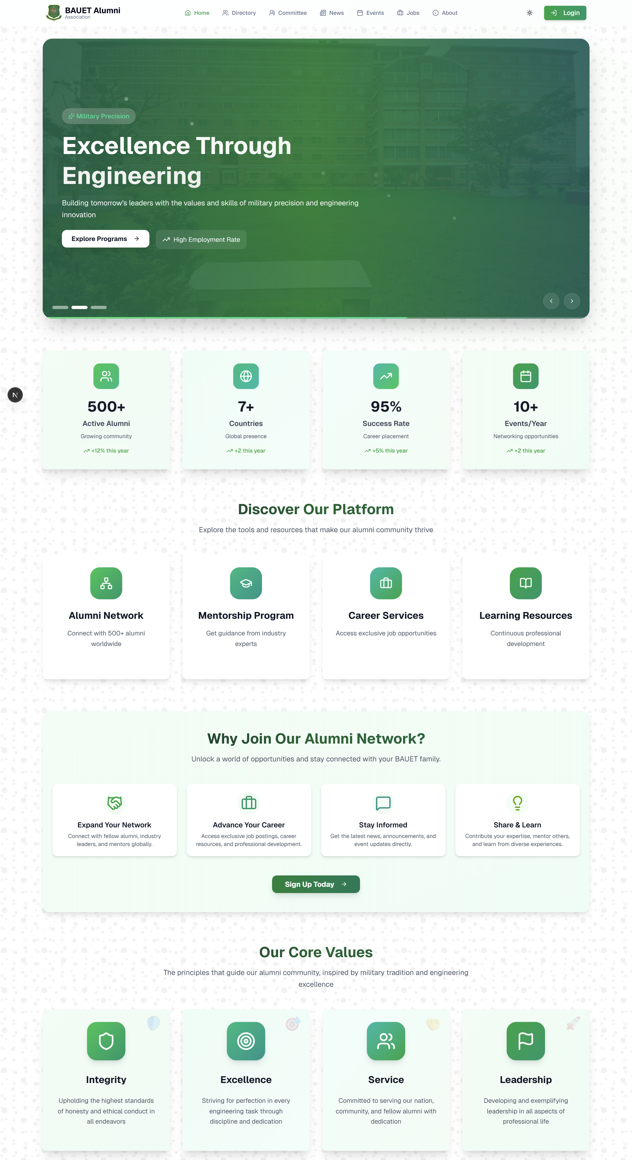
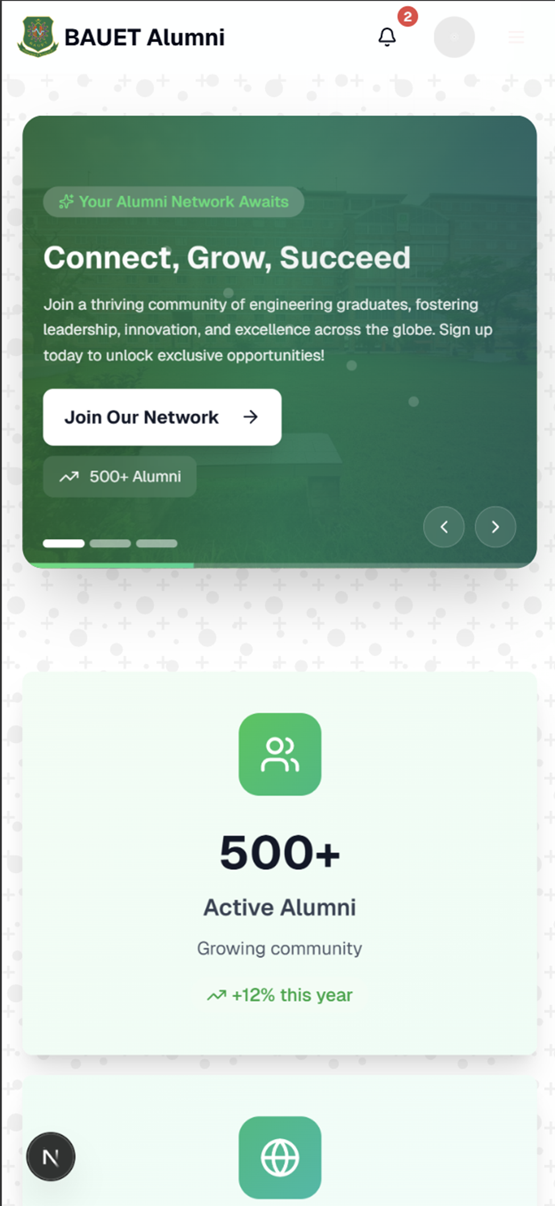
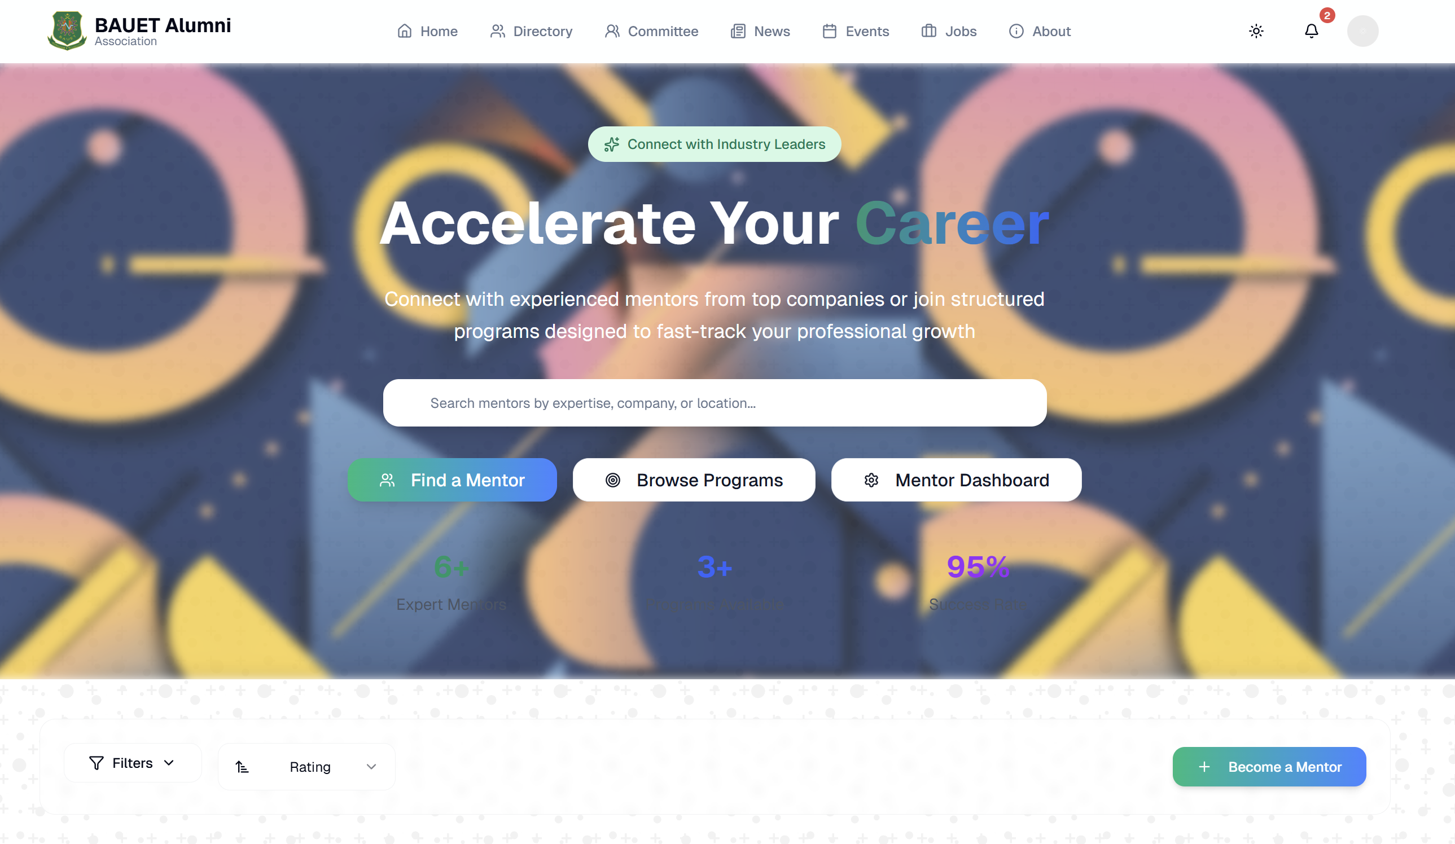
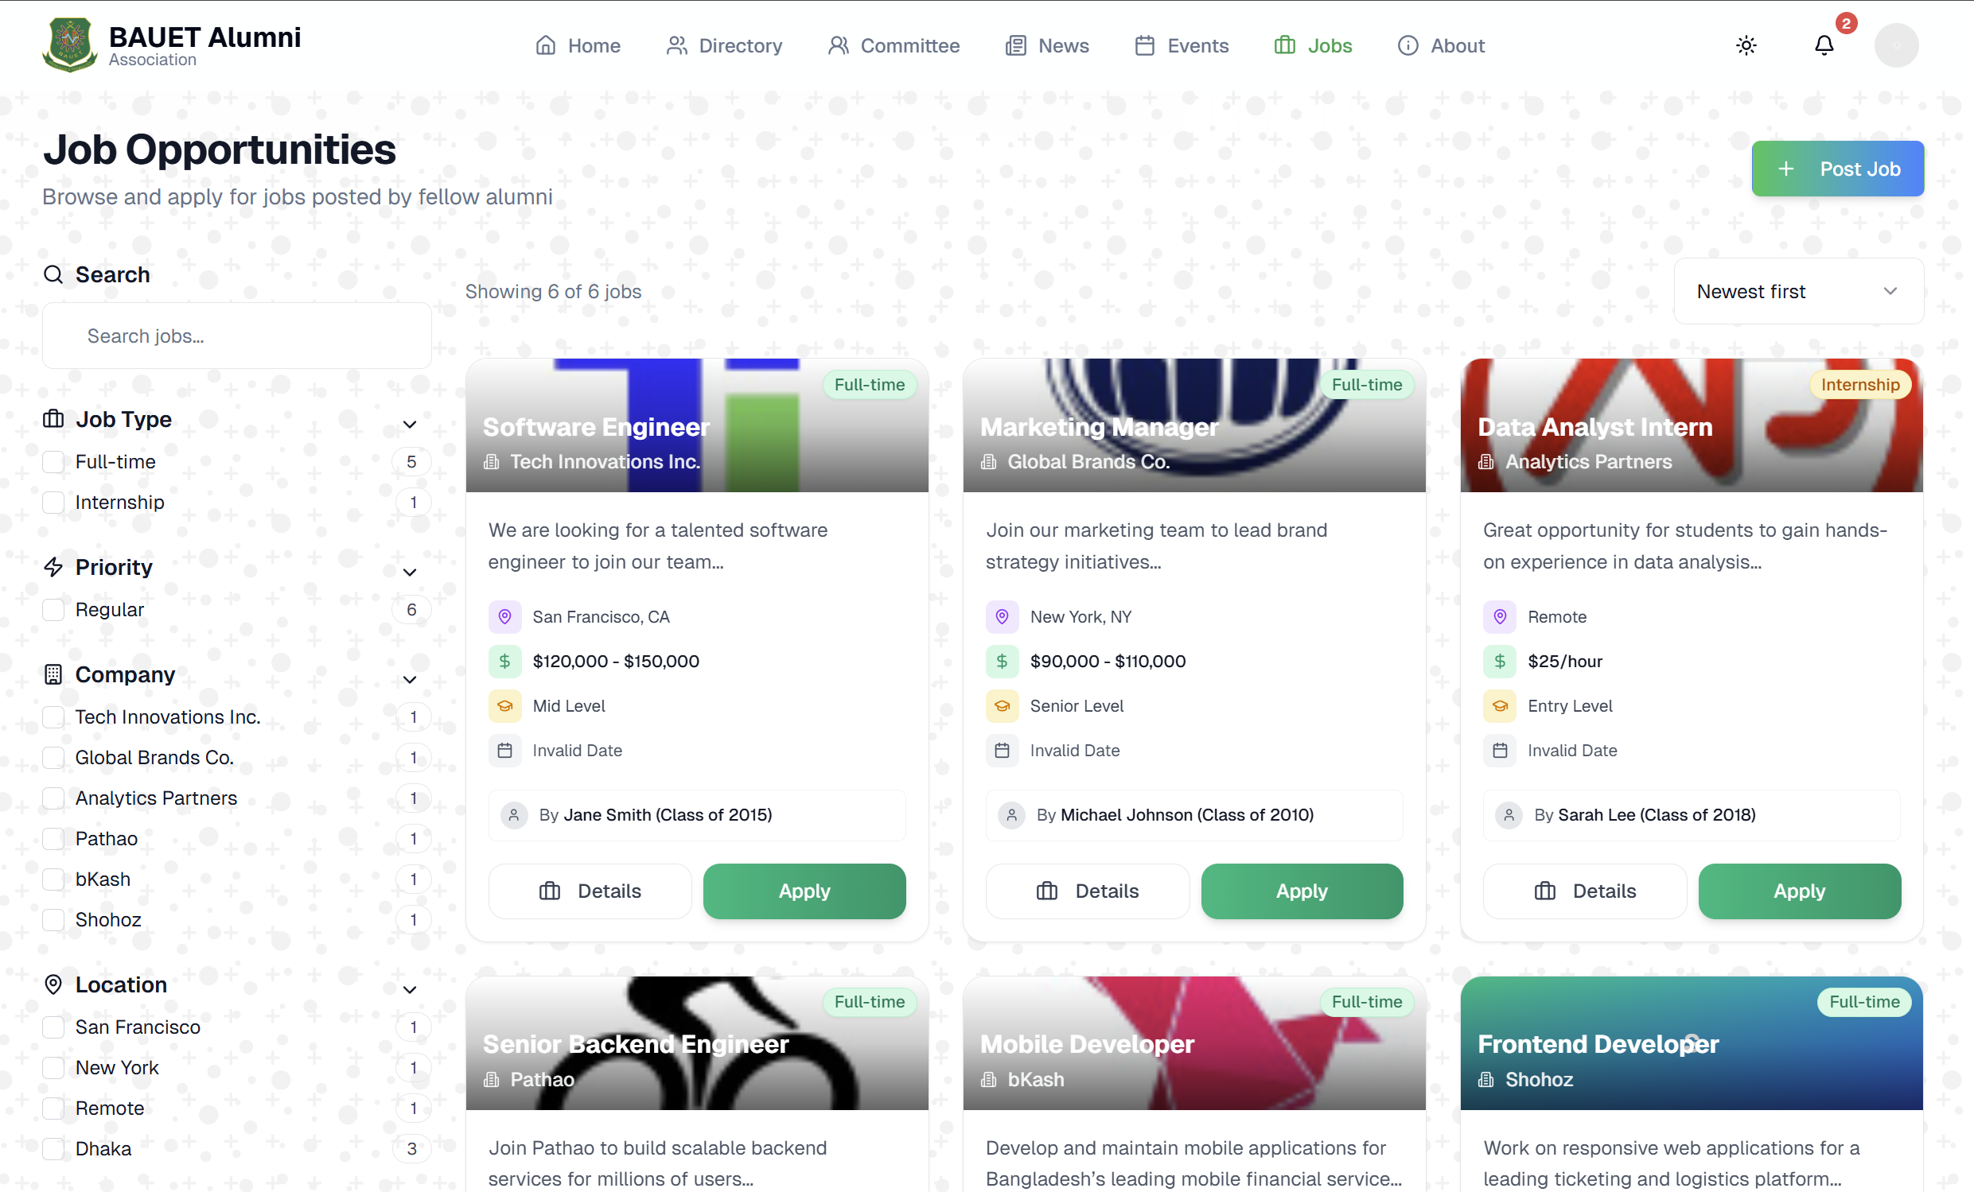
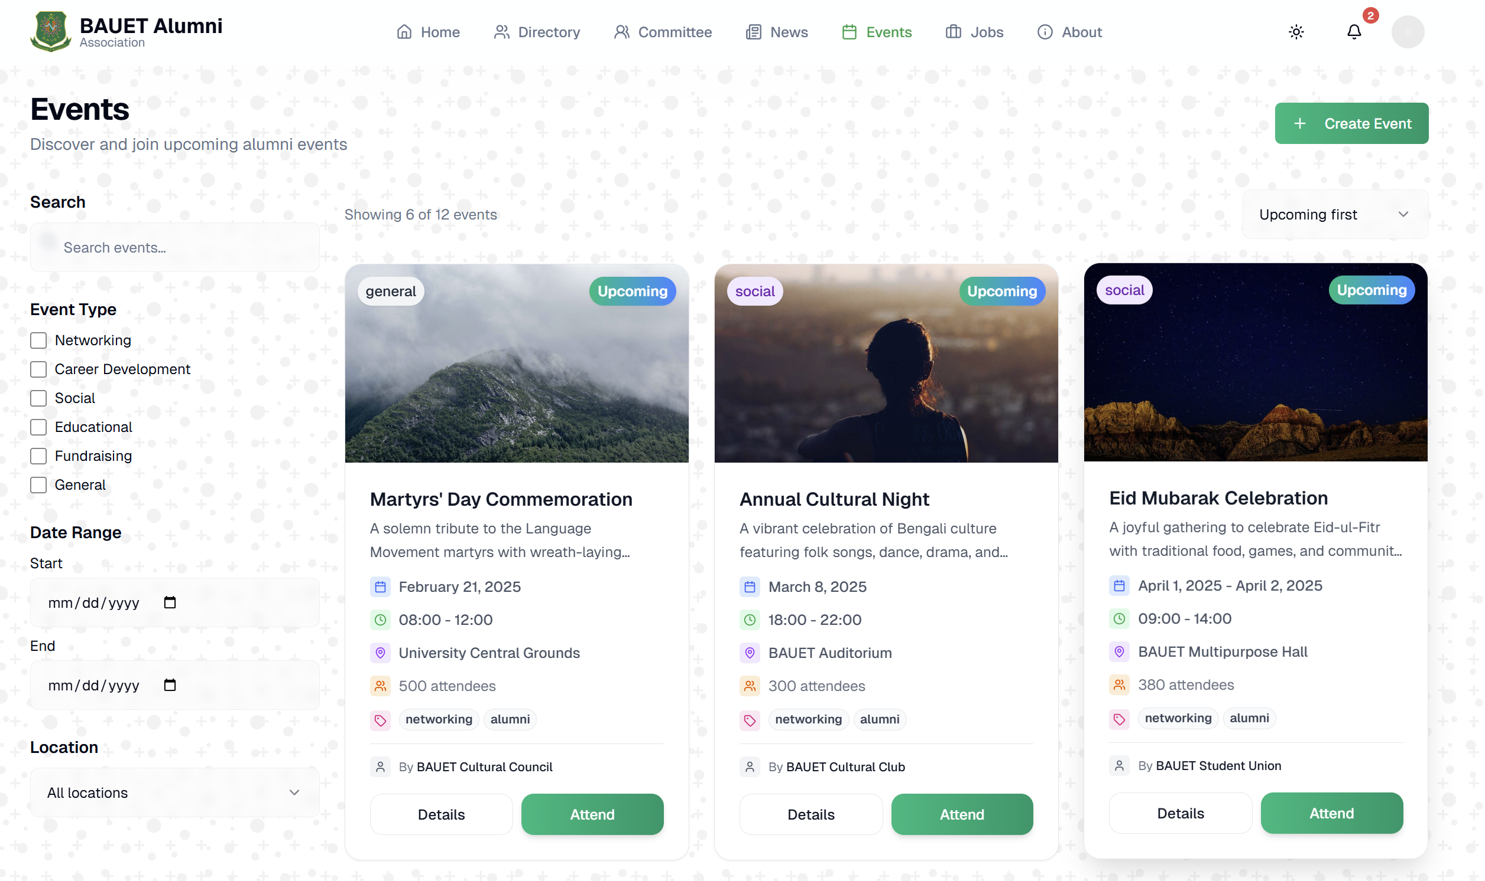
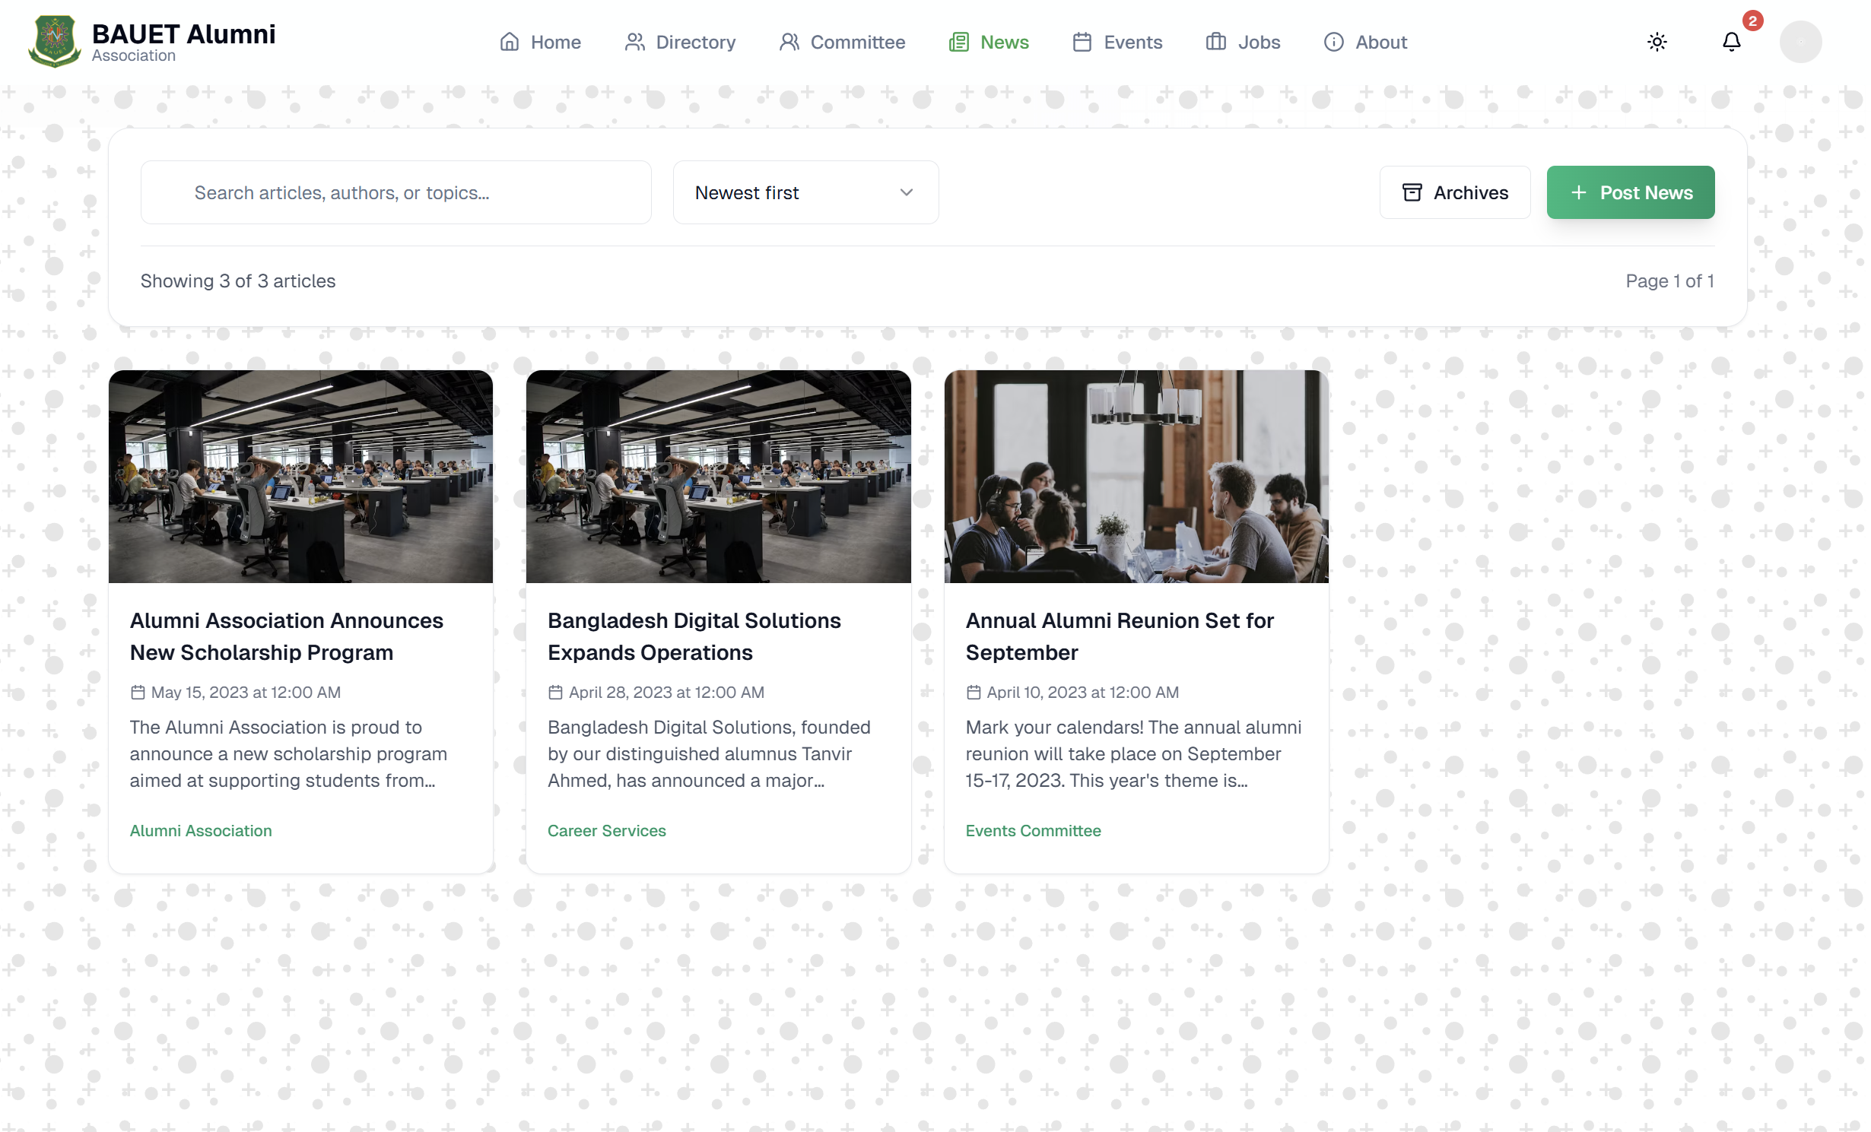
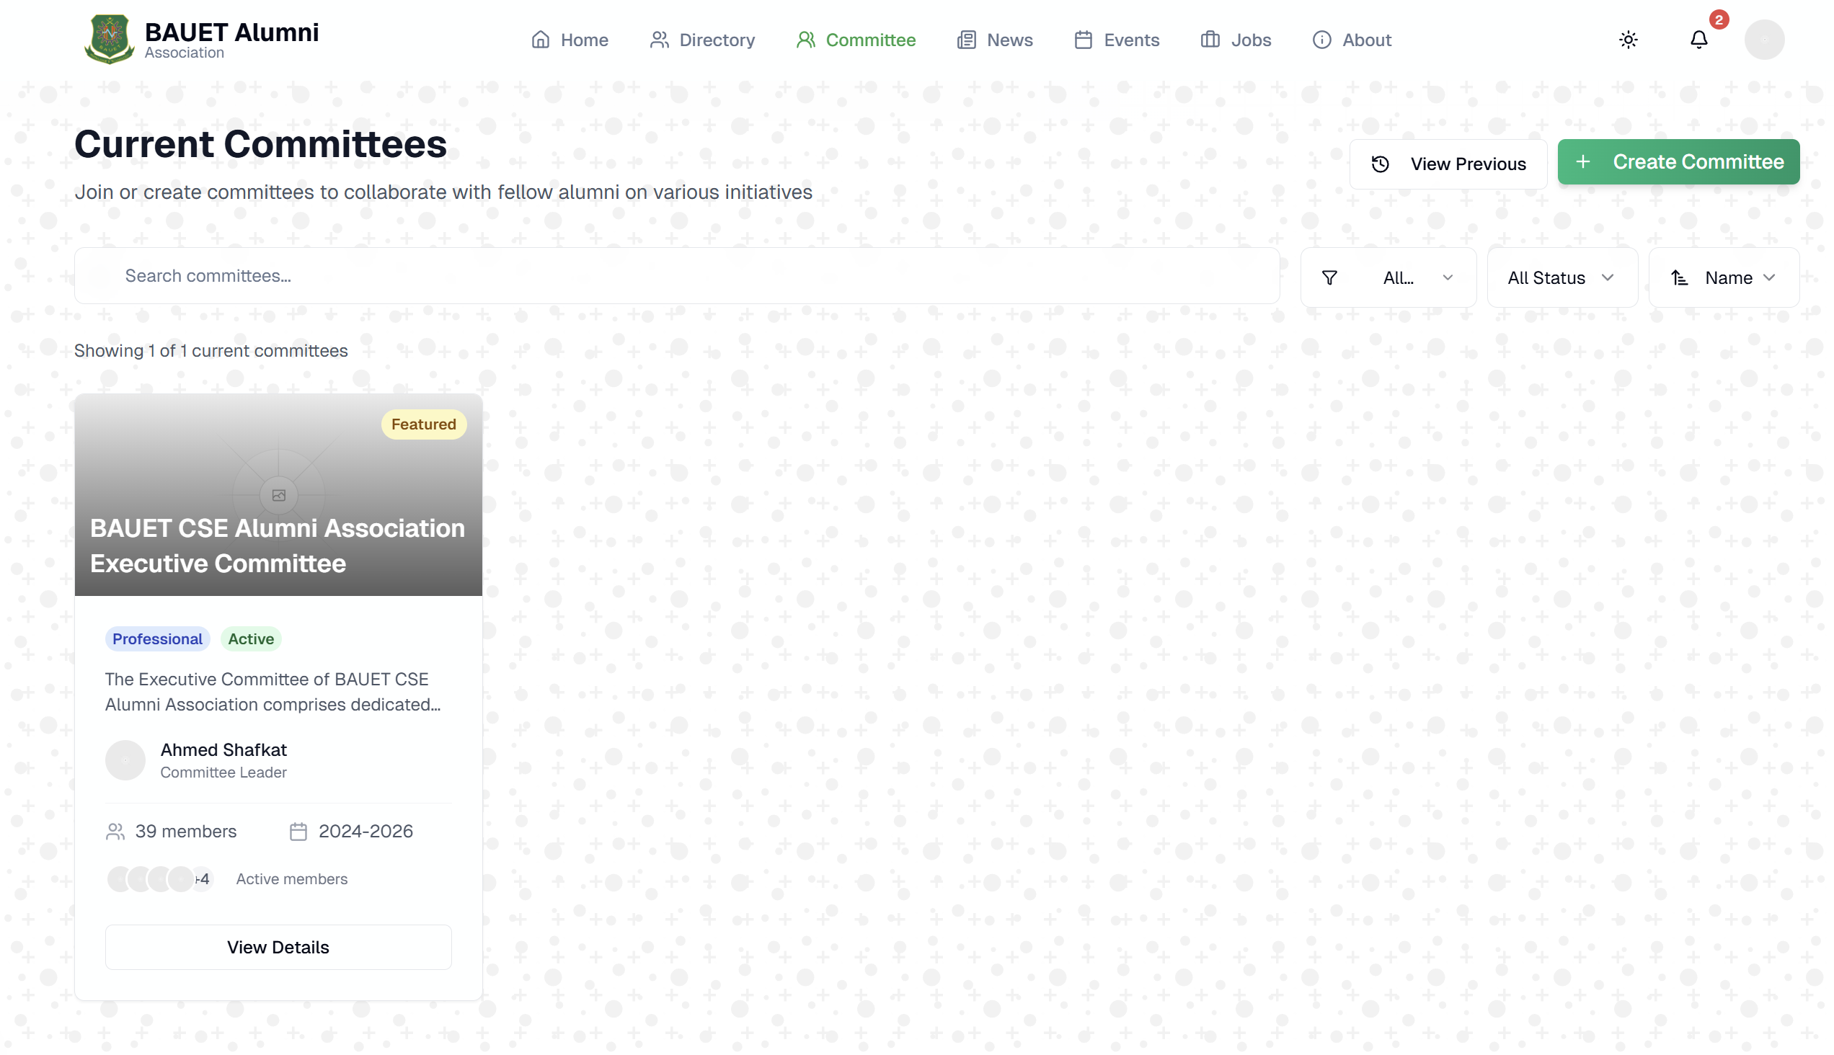
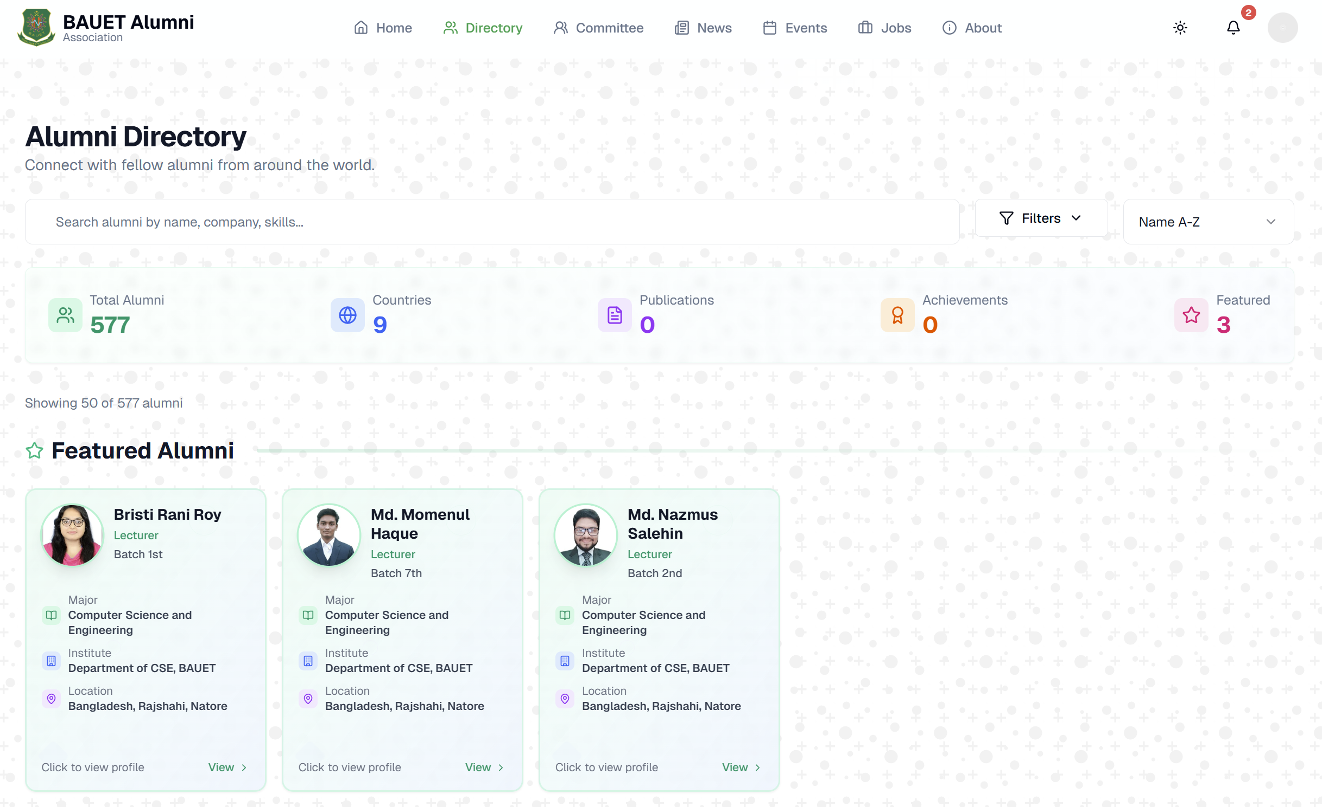
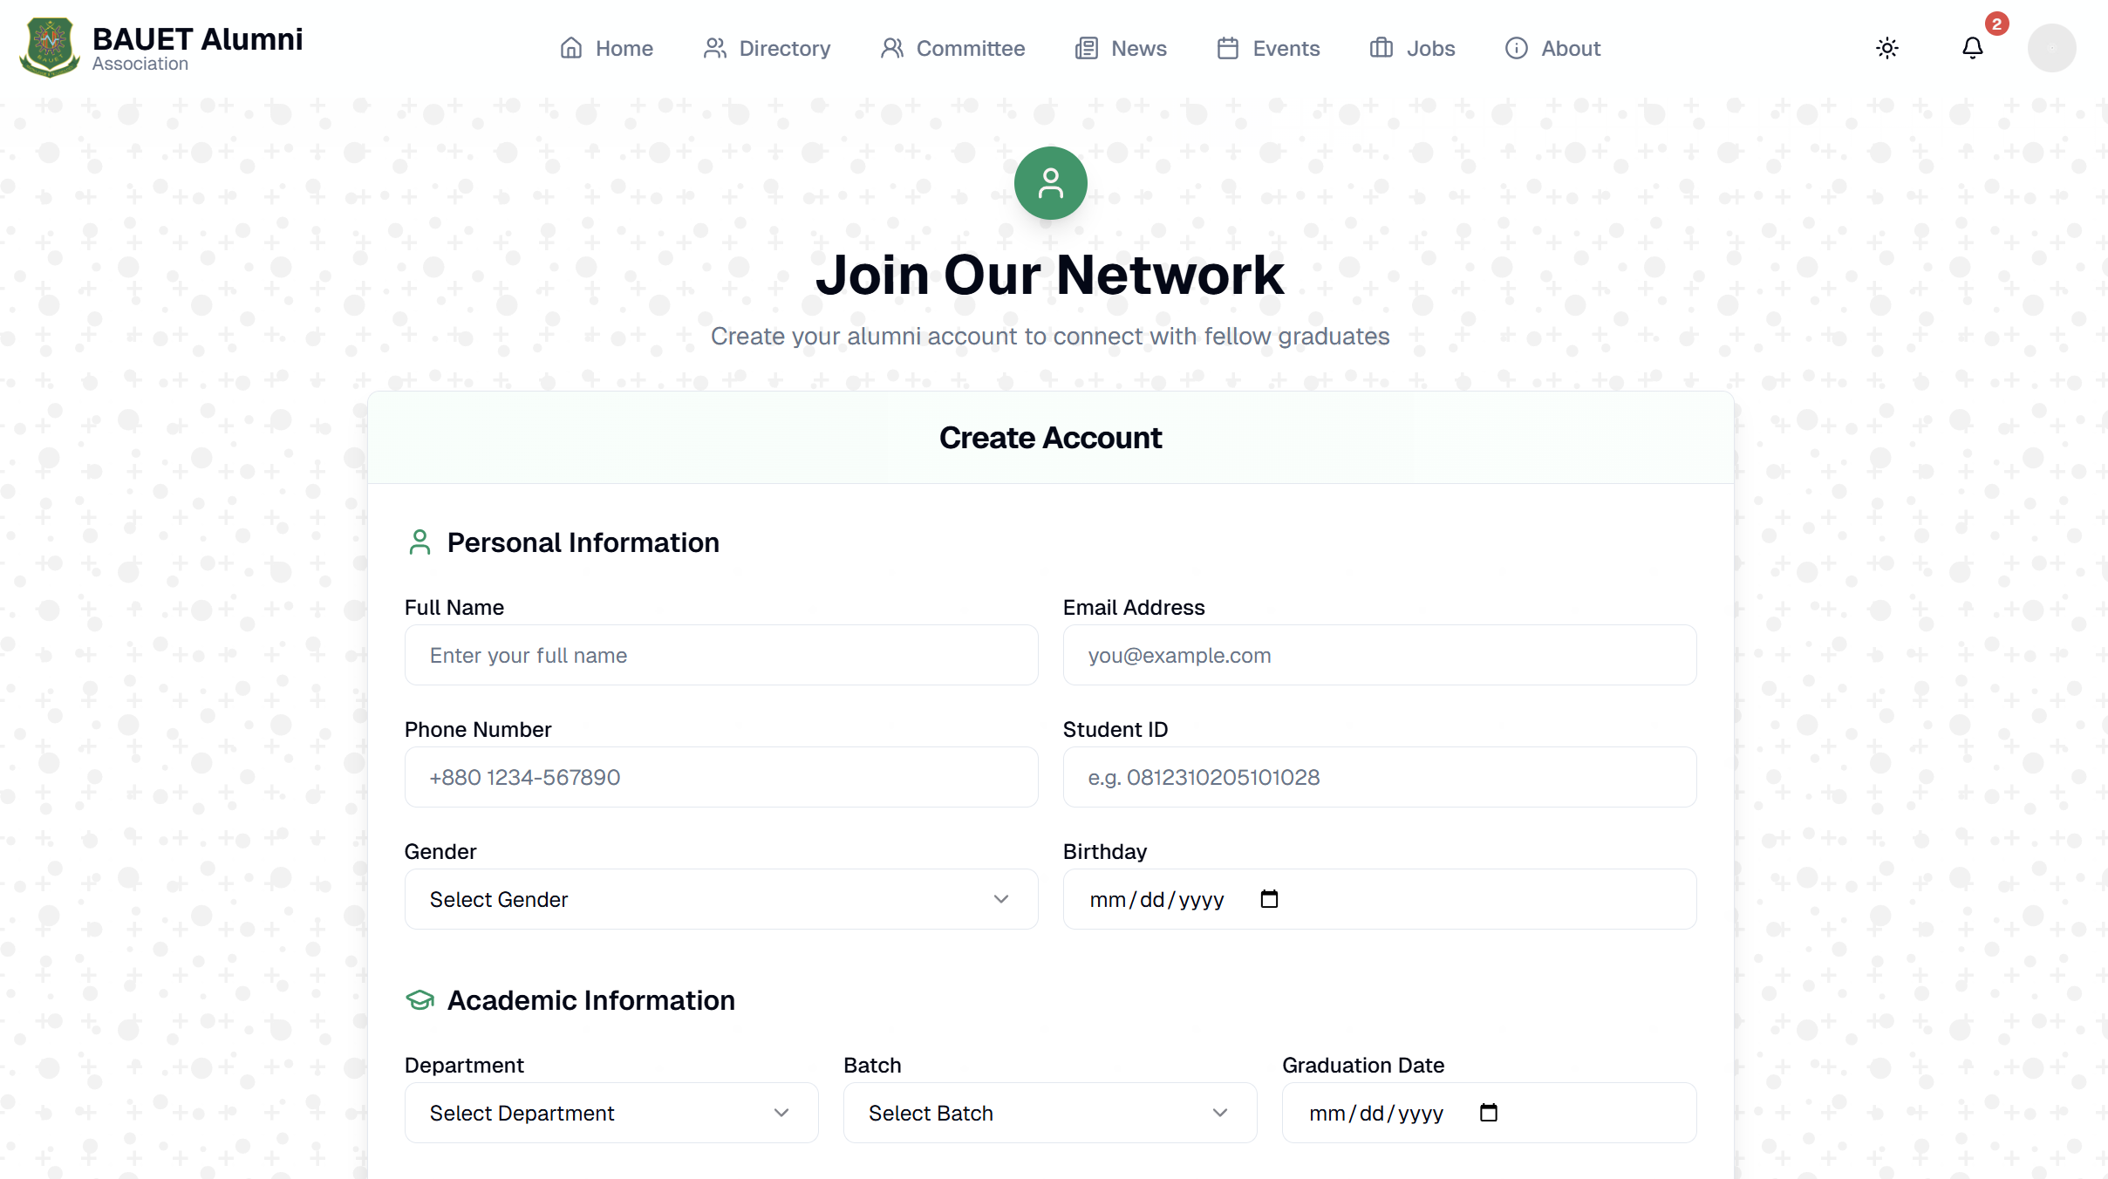
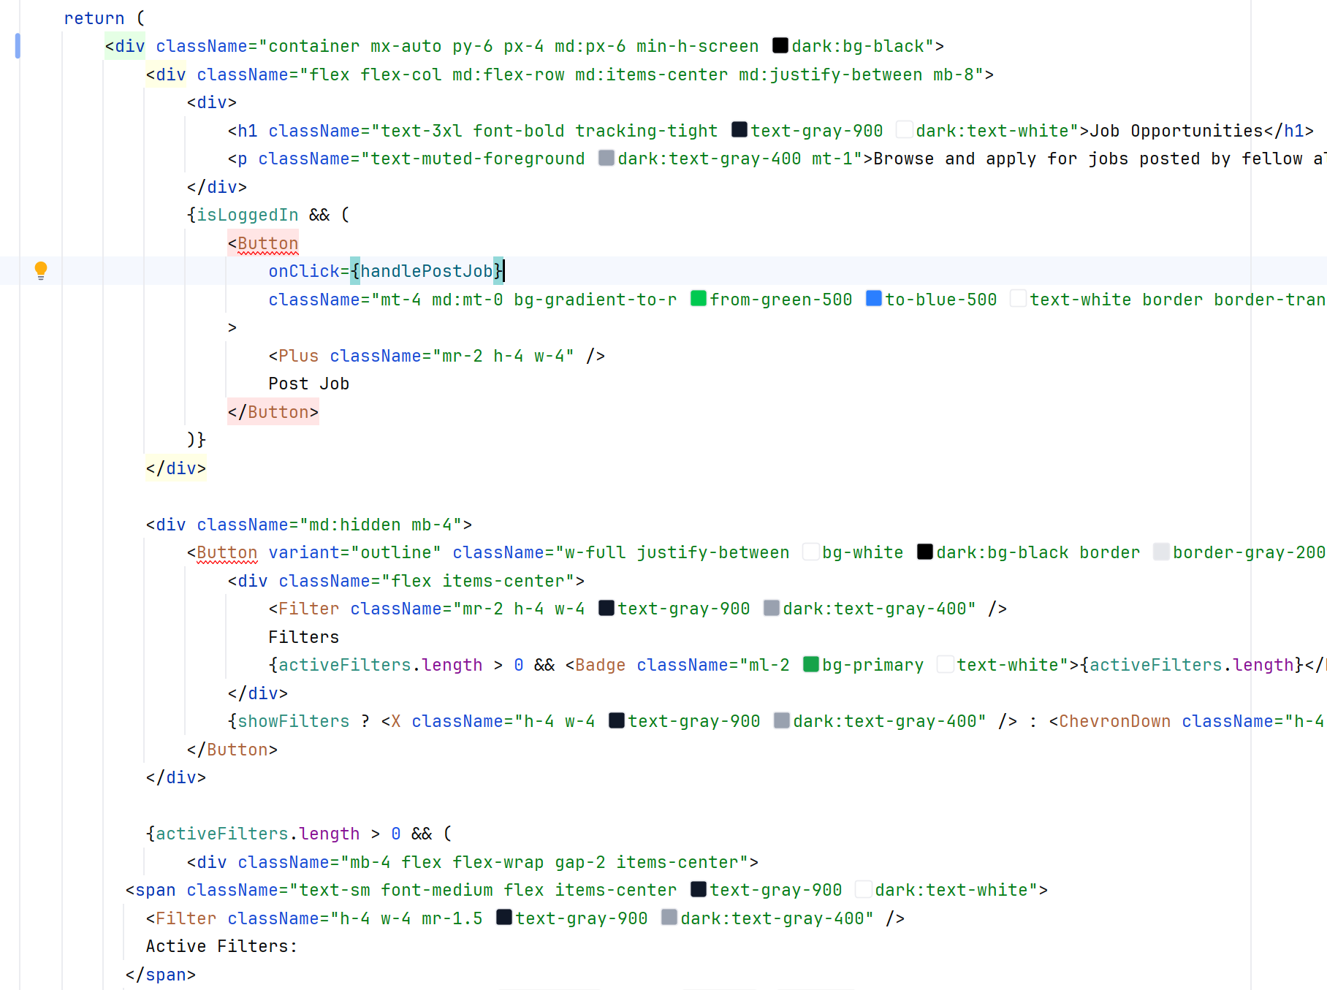
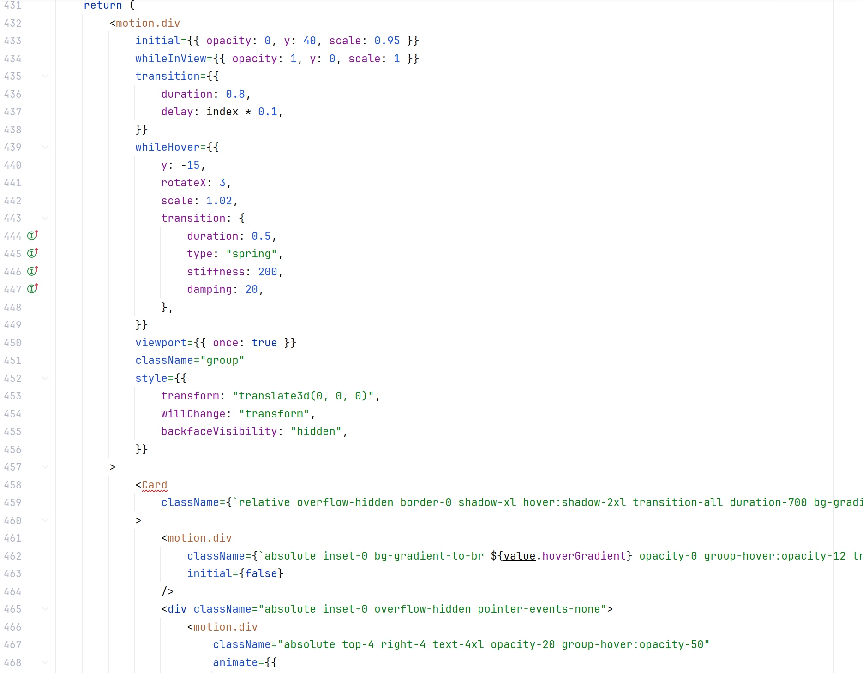









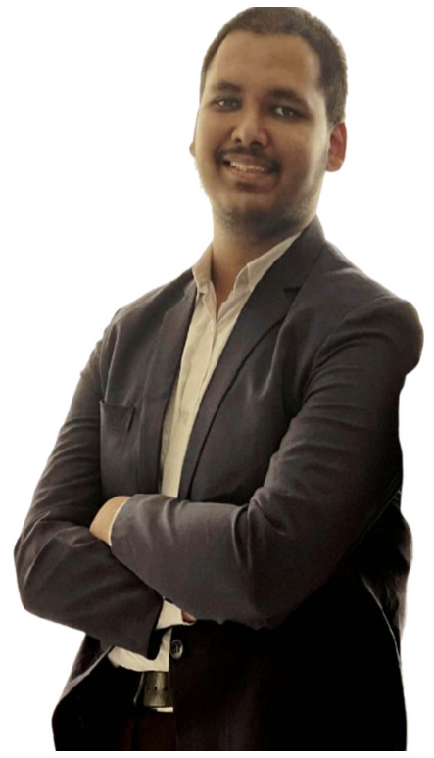


Project showcasing (software)
Team ByteForge
ALUMNI ASSOCIATION A comprehensive Alumni Management Portal developed for the Bangladesh Army University of Engineering & Technology (BAUET), designed to streamline alumni engagement, networking, and institutional collaboration
01.
User Friendliness
Unique Design
Consistent Interface
Accessibility
Responsiveness
Minimalistic
02.
Impactful
Features
Alumni Directory
Committee & Election
Mentorships
Job Posting
Events
News
03.
Secure
Platform
Authentication & Authorization
Data Encryption
Input Validation
Privacy Protection
Performance Guarantee
04.
Scalable
Maintainable
Clean Codebase
RESTful API
Postgress DB
Docker Support
Kubernetes Support
MEET THE HORSEMEN
SUPERVISED BY
Mohammed Golam Sarwar Bhuyan Professor & Dean, Faculty of ECE
Bangladesh Army University of Engineering & Technology (BAUET)
Md. Momenul Haque Lecturer, Department of CSE
Bangladesh Army University of Engineering & Technology (BAUET)
IMPORTANT NOTE
THIS PROJECT HAS BEEN INITIATED BY INSTITUTIONAL QUALITY ASSURANCE CELL (IQAC), BAUET
K. Mishkatul Azim
Zarif Ahnaf Dhrubo
Md. Muhiminul Islam

